Slide 1



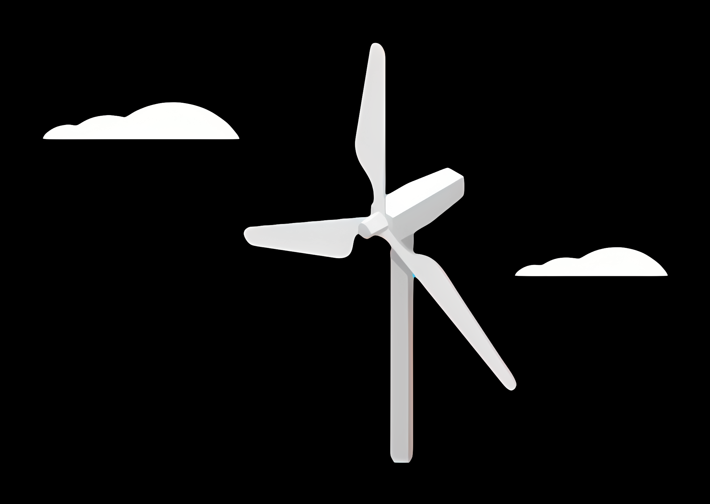
WEC Development Project
Electrical Drivetrain Design for Onshore Wind Turbines – Syria
Date: 30/09/2025
Supervisor: Prof. Rajesh Saiju
Group members : Aiswarya Vijayan, Vishranti Shivajirao Patil , Girish Mahadeo Padalkar, Cristina Milene Vergara Hernandez
Presnted By : Girish Padalkar
1

Slide 2

Agenda
Introduction
Market Analysis
Responsibilities in the team
Decision: location of components
Types of Drivetrain
Generator Technologies Overview
PMSG vs DFIG Comparison
Next Steps
References

Slide 3
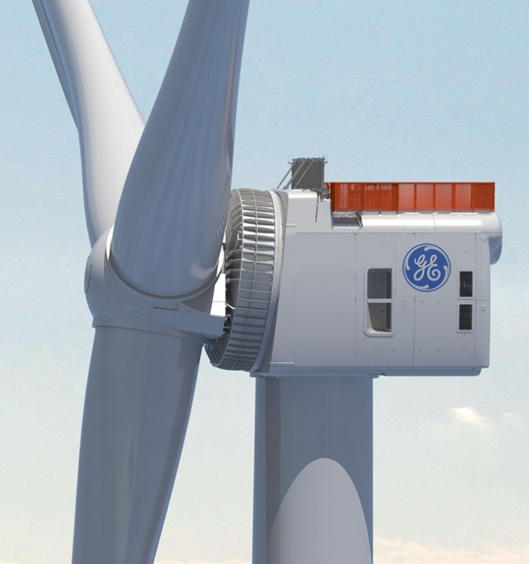
Introduction
Project scope:
To develop a reliable and efficient electrical drivetrain system tailored for onshore wind turbines in Syria’s renewable energy sector.
Syrian Wind Context
Syria possesses considerable onshore wind resources (Homs, Quneitra, Adra, Hassia).
• Recent tenders announced for 100–200 MW projects.
• Early pilot projects in Quneitra and feasibility studies in Homs.
• Drivetrain design must reflect weak grid conditions and maintenance challenges.
Source: www.ge.com/

Slide 4
Market analysis
Key players: “Production and supply of electrical drivetrain components “
Local Context: Syria has no large domestic turbine manufacturers, so reliance on imports & partnerships is essential.
International Developers: Siemens Gamesa, GE Vernova, Nordex, Vestas (potential entrants).
Recent Deals: ACWA Power signed 2.5 GW renewable MOU (1 GW solar, 1.5 GW wind, with storage) in 2025.

Slide 5
Market analysis
Government policies:
Syrian Ministry of Electricity issued 100–200 MW wind tenders in 2025.
International aid: World Bank, UNDP, NGOs financing hybrid and microgrid systems.
Long-term aim: Diversify from fossil fuels, stabilize weak grid, integrate renewables.
Source: Iberdrola awarded up to 200MW by German forest manager
| Windpower Monthly

Slide 6

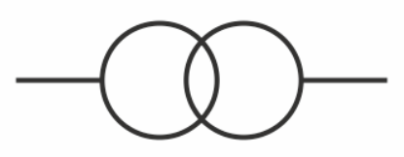

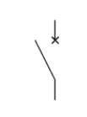
Responsibilities in the team
Electrical drivetrain components:
Generators : Girish Padalkar
Transformers : Vishranti Patil
Converters : Aishwarya Vijayan
Cables & switch gears : Cristina Vergara

Slide 7
Decision: location of components
mechanical drivetrain
SG
Converter
Transformer
Switchgear

Slide 8
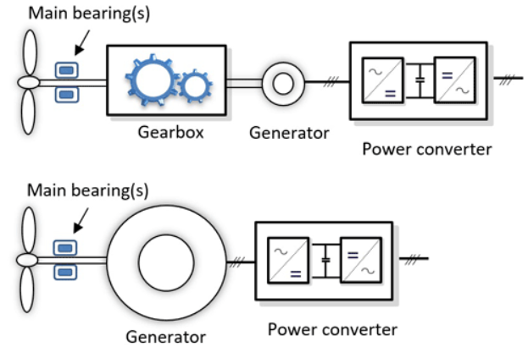
Types of Drivetrain
The two primary categories of drivetrain :
1. Geared Drivetrain Systems :
Doubly Fed Induction Generators (DFIG)
Generators with Full-Power Converters (GFPC)
2. Direct-Drive Systems: These eliminate the gearbox, connecting the rotor directly to a low-speed, high-torque generator. ((Permanent Magnet Synchronous Generators (PMSG))
Source: Wind Energy Science (WES)

Slide 9
Generator Technologies Overview
Generator Type | Description | Converter Type
PMSG/PESG | Permanent Magnet or Excited Synchronous Generator | Full-scale
FESG | Field Excited Synchronous Generator | No converter
SCIG | Squirrel Cage Induction Generator | No converter
DFIG | Doubly-Fed Induction Generator | Partial-scale

Slide 10
Quantitative Comparison
Generator | Weight (tons) | Cost (USD) | Maintenance | Reactive Power
PMSG | ~25 | $300k+ | Low | ±0.65 MVAr
DFIG | ~20 | $200k | Medium | ±0.65 MVAr
SCIG | ~18 | $150k | High | External only
FESG | ~22 | $220k | High | ±0.5 MVAr

Slide 11
Next Steps
Planning:
align our milestone planning with the other teams
Technical:
Generator: more detailed estimation of dimensions (size & rotational speed)
Converter: first research and dimensioning
Transformer: first research and rough estimation of size

Slide 12
References
https://www.siemensgamesa.com/global/en/home/products-and-services/onshore.html
https://www.gevernova.com/wind-power/onshore-wind/3mw-platform
https://www.nordex-online.com/en/product/platforms/#delta4000
Wind energy (irena.org)
https://wes.copernicus.org/articles/7/387/2022/
Energy world
Ev business directory
Global wind Energy council (GWEC)
Mordor Intelligence
National Institute of Wind Energy (NIWE)

Slide 13
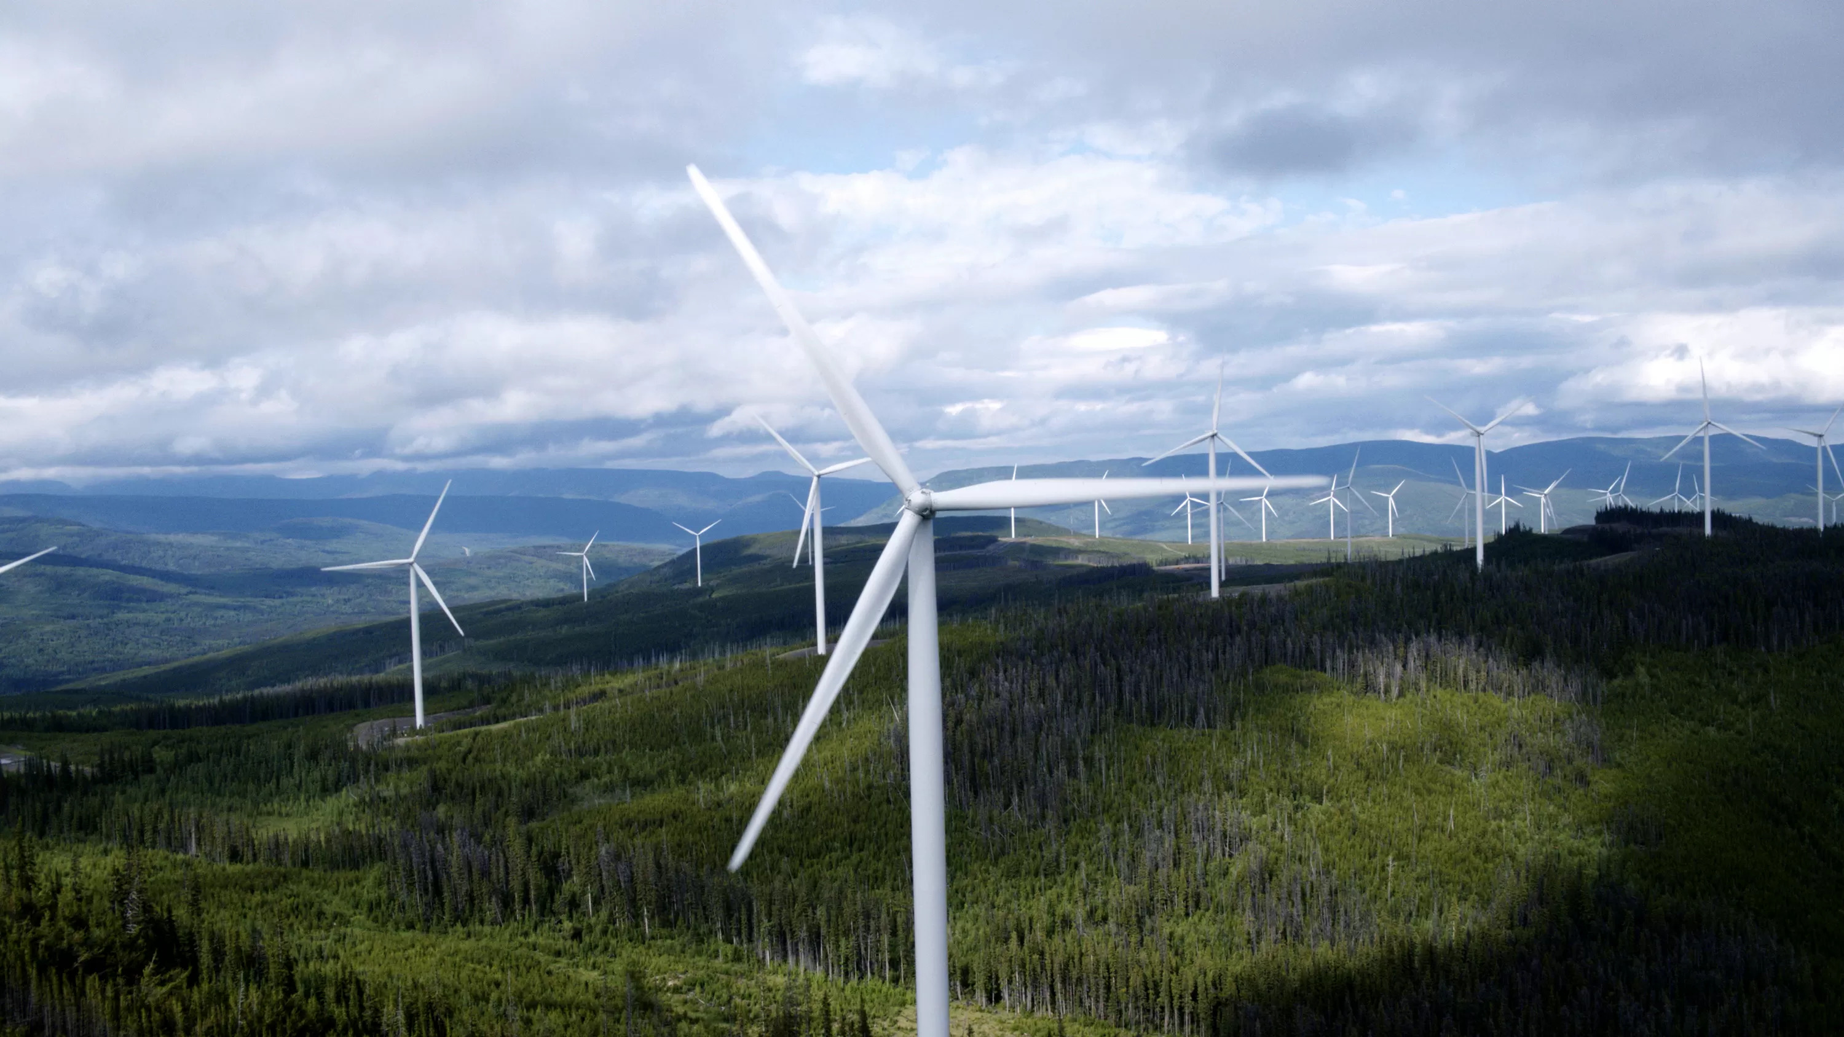
Thank you for your attention
Source: SSAB Zero™ Used in GE Vernova Onshore Wind Towers - SSAB

